Slide 1
Employee Salary Prediction
CAPSTONE PROJECT
Presented By:
Aditya Pawar
Vidya Pratishthan’s Kamalnayan Bajaj Institute of Engineering and Technology, Baramati
Department – Information Technology

Slide 2
OUTLINE
Problem Statement (Should not include solution)
System Development Approach (Technology Used)
Algorithm & Deployment (Step by Step Procedure)
Result
Conclusion
Future Scope(Optonal)
References

Slide 3
Problem Statement
The goal of this project is to develop a machine learning model that accurately predicts the salary of an employee based on various features such as education, experience, job title, and company location. This problem arises from the need for better compensation benchmarking in HR and business analytics. Organizations can use such models to streamline payroll decisions, improve talent acquisition, and reduce manual estimation errors. By leveraging historical data and regression techniques, we aim to create a reliable salary prediction tool. The project focuses on preprocessing, feature engineering, model selection, and deployment.

Slide 4
System Approach
System Requirements:
Python 3.x
Jupyter Notebook Libraries Used:
pandas, numpy, matplotlib, seaborn
scikit-learn
Dataset:
A CSV dataset containing employee profiles and salary details

Slide 5
Algorithm & Deployment
Step-by-Step Procedure:
Data collection and loading (CSV format)
Data cleaning and preprocessing (handling nulls, encoding, normalization)
Feature selection and data visualization
Splitting dataset into training and testing sets
Model training using Random Forest Regressor
Evaluating performance with accuracy metrics (R² Score, MAE, RMSE)

Slide 6
Result
GitHub Link: https://github.com/Aditya4386/ASD_Internship

Slide 7
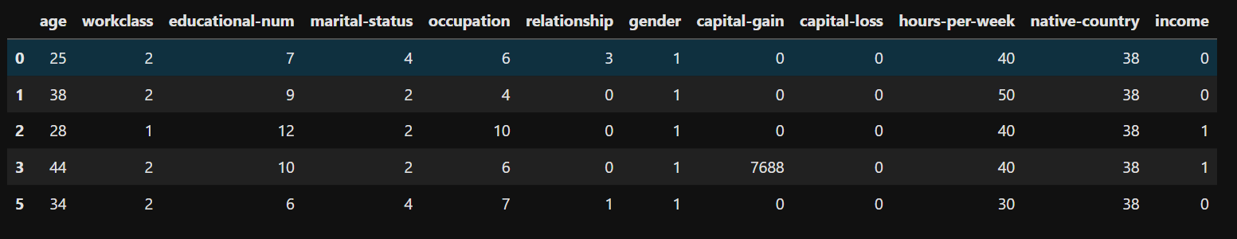
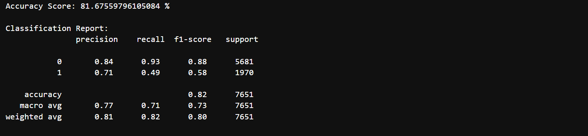
Dataset after cleaning
Model training output

Slide 8
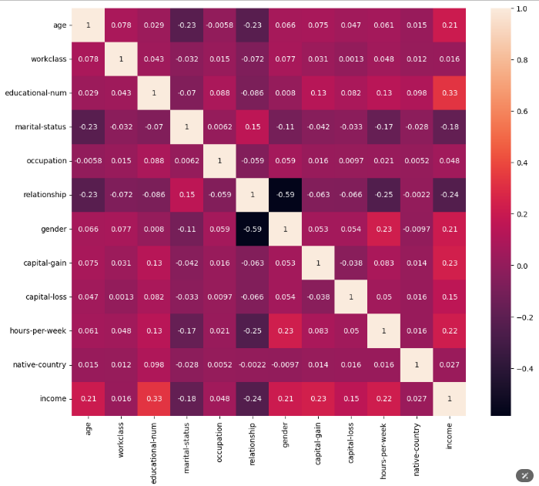
Feature correlation heatmap

Slide 9
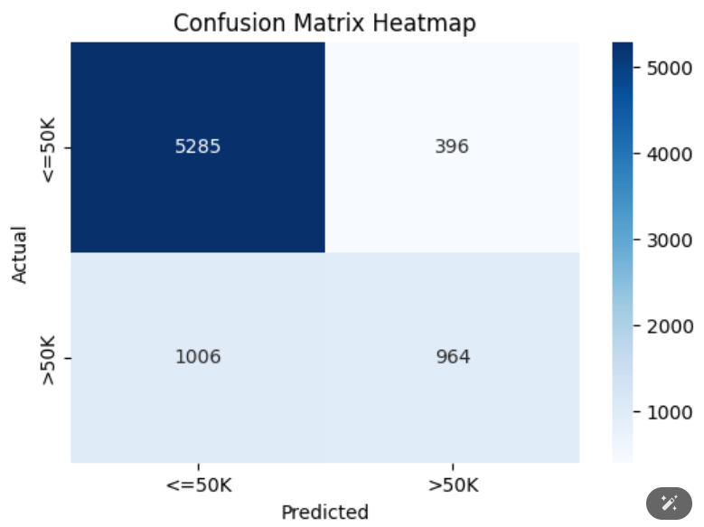
Performance metrics (R² Score, etc.)

Slide 10
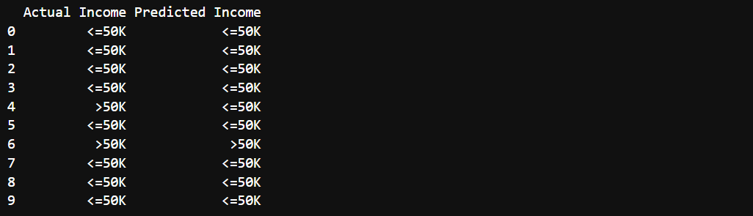
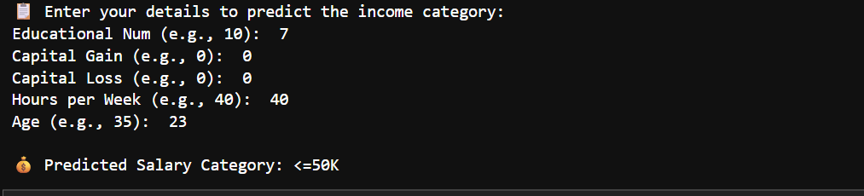
Final predicted results

Slide 11
Conclusion
The developed model accurately predicts salaries with a reasonable error margin.
Random Forest Regressor performed better due to its ability to handle non-linear relationships.
Feature selection and proper data preprocessing played a critical role.
Challenges included handling categorical variables and ensuring model generalization.

Slide 12
Future scope
Integrate with live HR databases and dashboards
Use deep learning for improved prediction accuracy
Build a REST API or deploy with Flask/Streamlit
Handle salary predictions across multiple industries or geographies

Slide 13
References
scikit-learn documentation
Kaggle datasets for salary prediction
TowardsDataScience articles on Regression Models
Machine Learning by Andrew Ng (Coursera)
Python for Data Science resources (GeeksforGeeks, Analytics Vidhya)

Slide 14

THANK YOU

